Slide 1
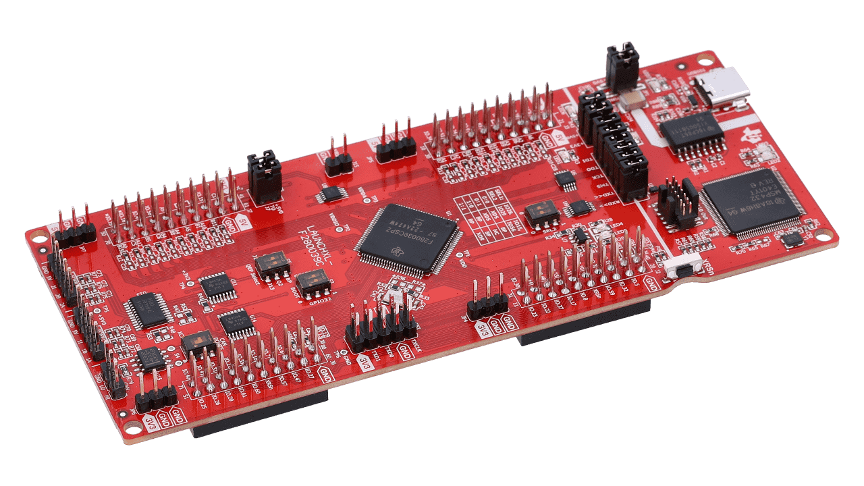

ECEN 403 Final Presentation
Team 12 ADC Resolution vs. Sensorless Motor Control Performance
Team Members: Tamara Basfar, Cristian Ornelas, Tyler Hawkins, & John King
Sponsor: Texas Instruments (Kevin Allen)

Slide 2
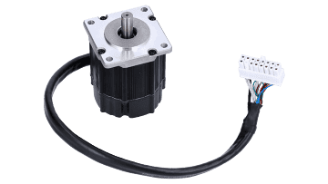
Project Overview
Problem
Conventional motor systems usually depend on sensored motor control to supply feedback, but these sensors can malfunction, particularly in unfavorable environments. There is an increasing need to simplify systems, improve dependability, and decrease cost expenses. On the other hand, with sensorless motor control, the drawback is that there is a lack of feedback at low speeds during startup.
Solution?

Slide 3
Project Overview
Proposed solution
Develop software for sensorless motor control on one of TI’s newest c2000 devices with enhanced features, and conduct an array of tests on the software to determine what set of sensorless control parameters are most effective.

Slide 4
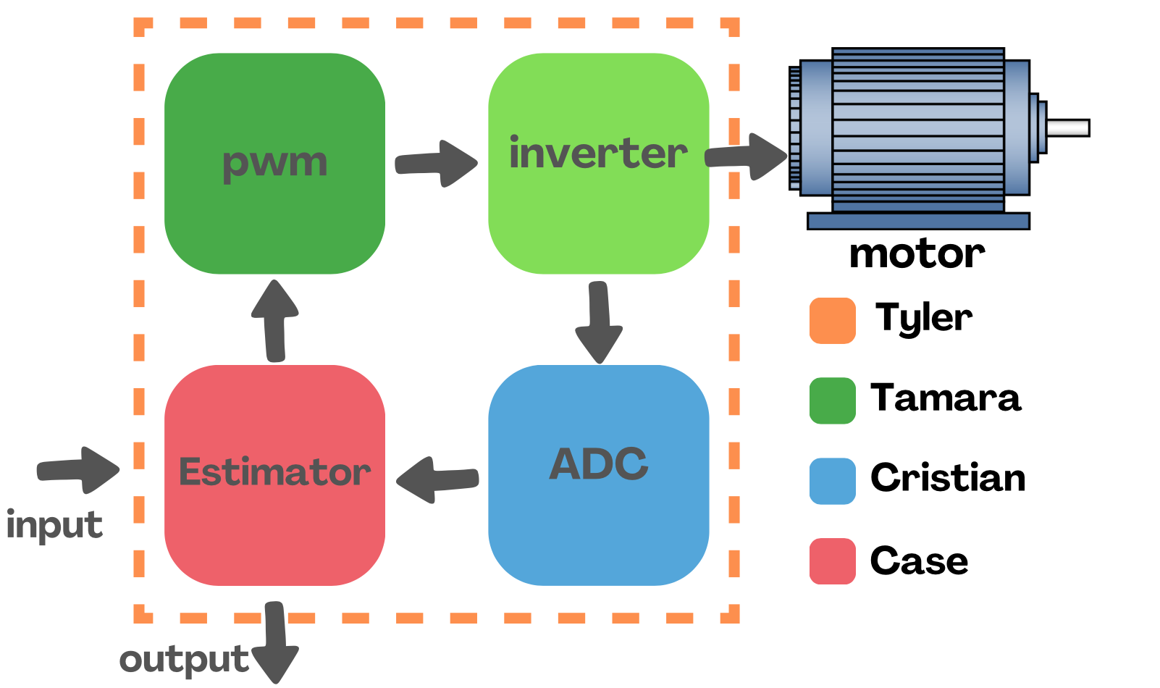
System overview
Block diagram

Slide 5
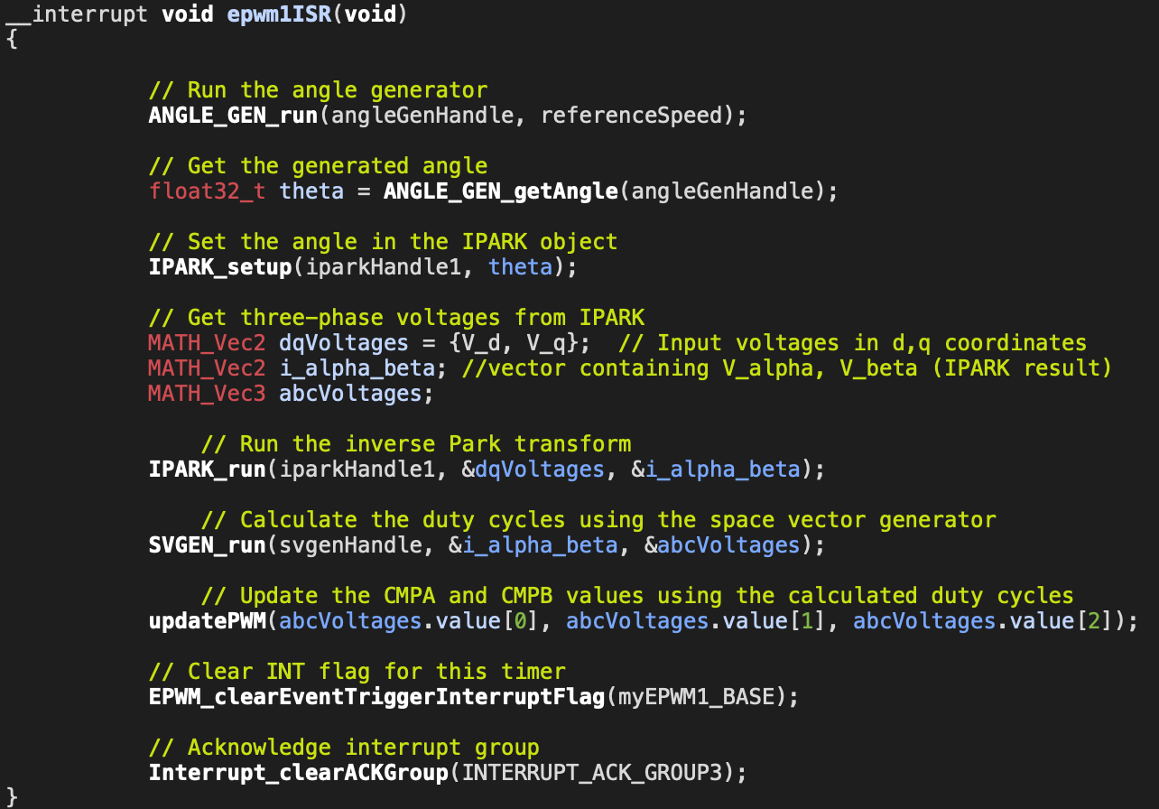
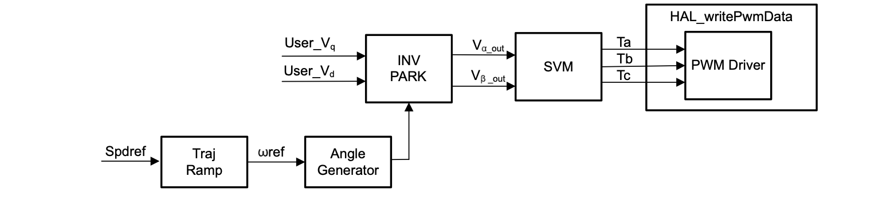
Pulse Width Modulation
System Overview
The diagram illustrates the signal flow from user inputs to PWM output in open loop control.
Functions developed: Angle generator, INV PARK, SVM, PWM.
ISRs control real-time system behavior.
Goal: Ensure accurate and efficient signal modulation.

Slide 6
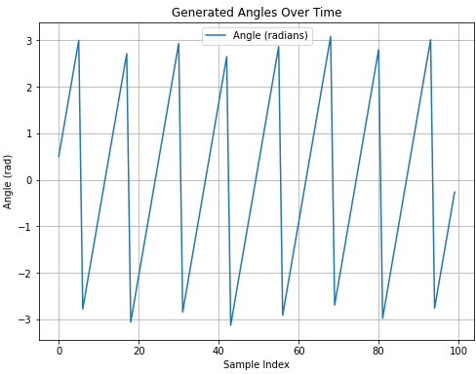
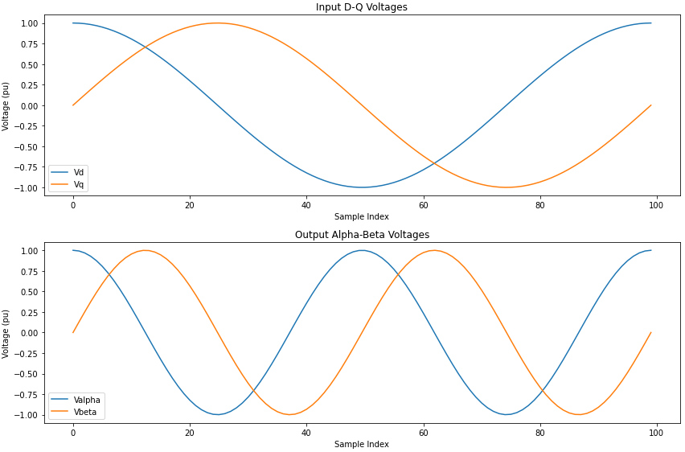
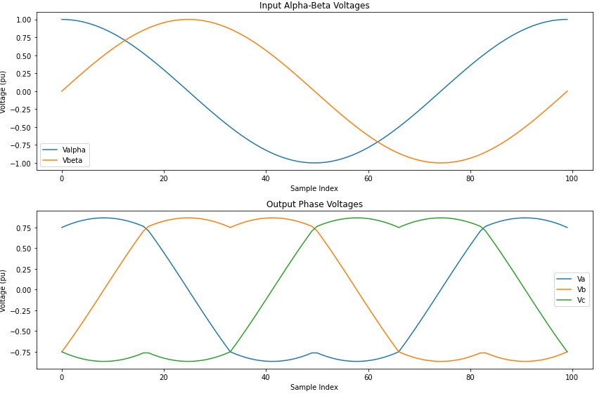
function testing Results
1)
All functions tested successfully in isolation.
1) Angle generator
2) inverse park
3) space vector modulation
2)
3)

Slide 7
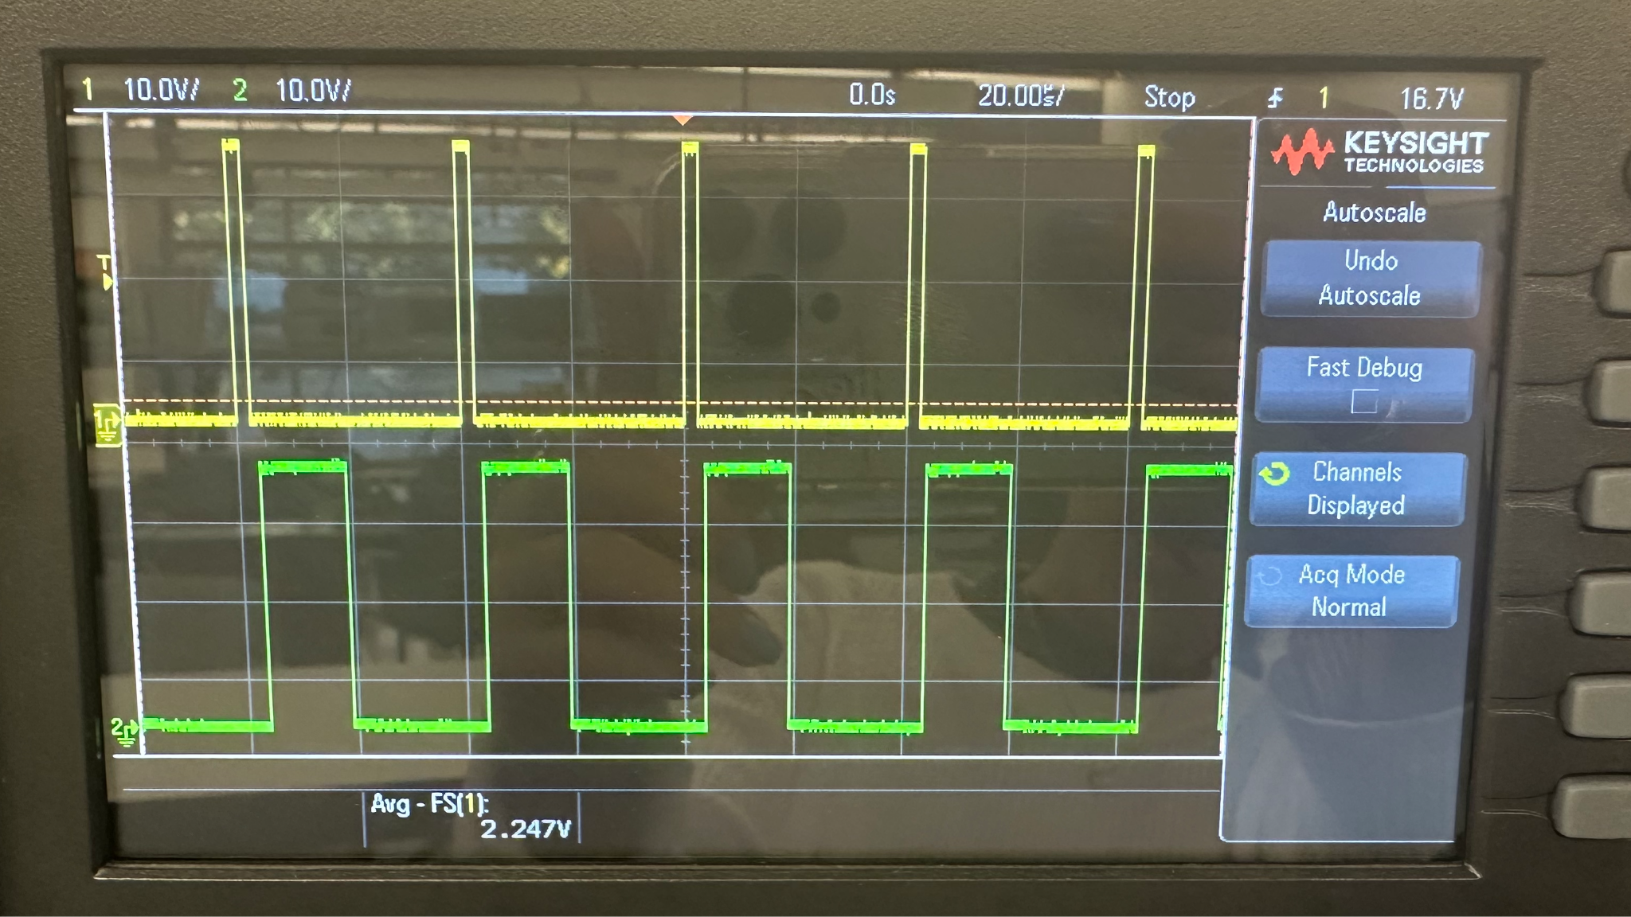
PWM
full PWM result and challenges
Challenges:
Program stalls during execution, likely due to interrupt handling.
Difficult to trace the source of the issue because the program stalls before hitting high-level code.
Likely causes: Incorrect interrupt vector mapping or improper initialization.
Resolutions:
Verify interrupt vector table and ensure correct mapping to ISR functions.
Review and debug low-level initialization code
Add diagnostic checkpoints or logs to verify execution flow before reaching the ISRs.

Slide 8
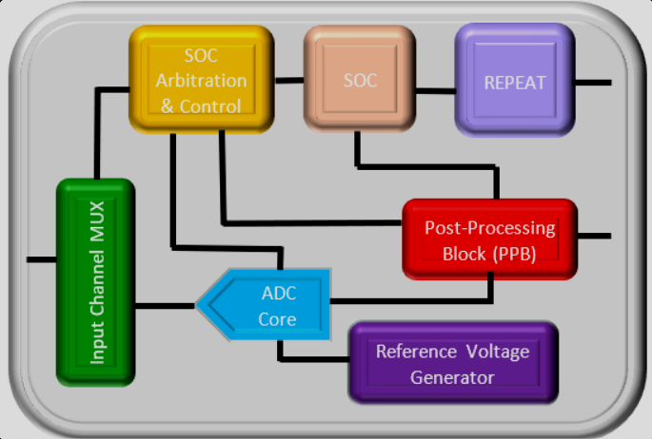
Analog-To-Digital Converter Driver
Cristian Ornelas
System Overview
The diagram shows the flow of the ADC Driver starting from the EPWM module to the end of conversion (EOC) interrupt to copy the results to a results buffer in the memory
3 ADC Modules simultaneously convert and output data
Goal: Generate an interesting input signal by incorporating different GPIO toggles.

Slide 9
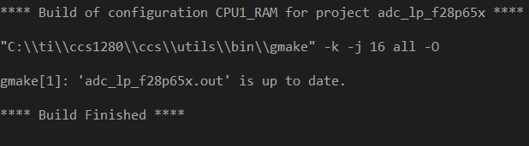
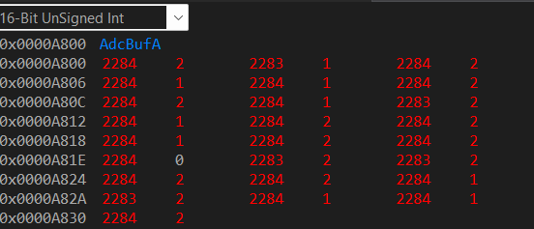
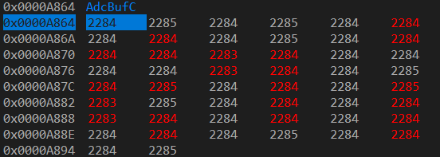
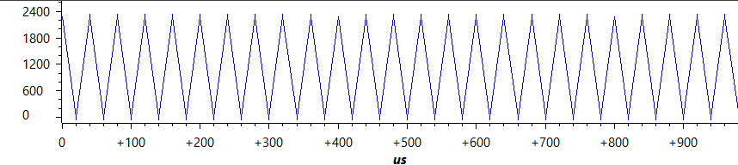
ECEN 403 Accomplishments/ Plans
Accomplishments
Code compiles with 0 errors.
The memory result buffer shows the behavior of ADC A (Toggle)
The memory result buffer shows the behavior of ADC B (Low)
The memory result buffer shows the behavior of ADC C (High)
Code Composer Studio shows the PWM waveform updating in real time
Use Sysconfig. to set the parameters of the ADC modules.
Rest of 403…
The memory result buffer will show the behavior of ADC B (Low)
LEDs show the behavior of the GPIO pin on the f28p65x board

Slide 10
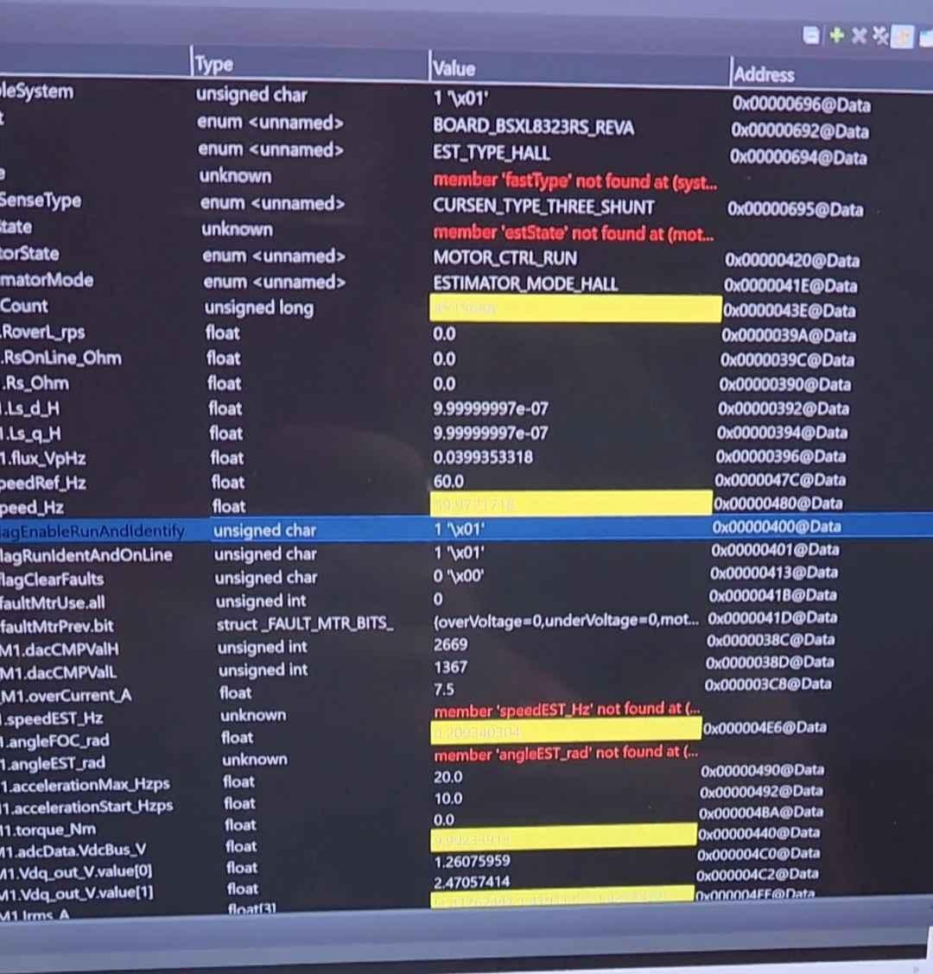
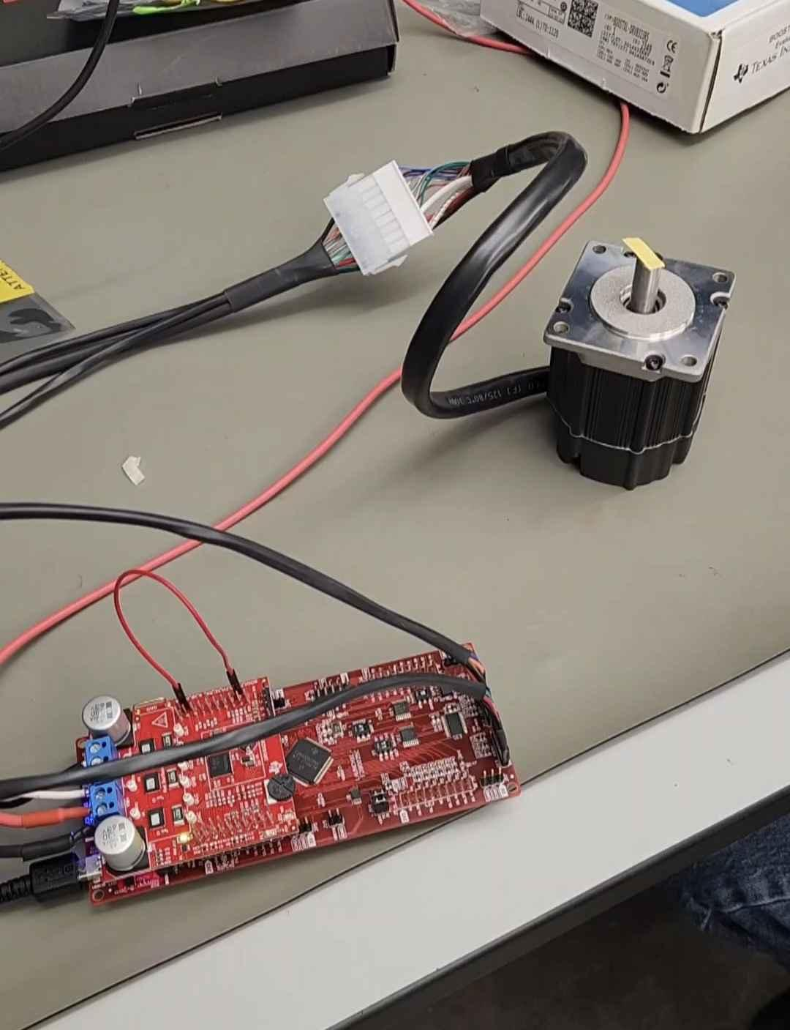
Solution Porting
System Overview and accomplishments
Accomplishments
Able to run solution on older F28002x board Completed sensorless testing on F28002x board Updated projectspec file Updated cmd linker files Updated hall.c file Updated hall.h file Full system build successful

Slide 11
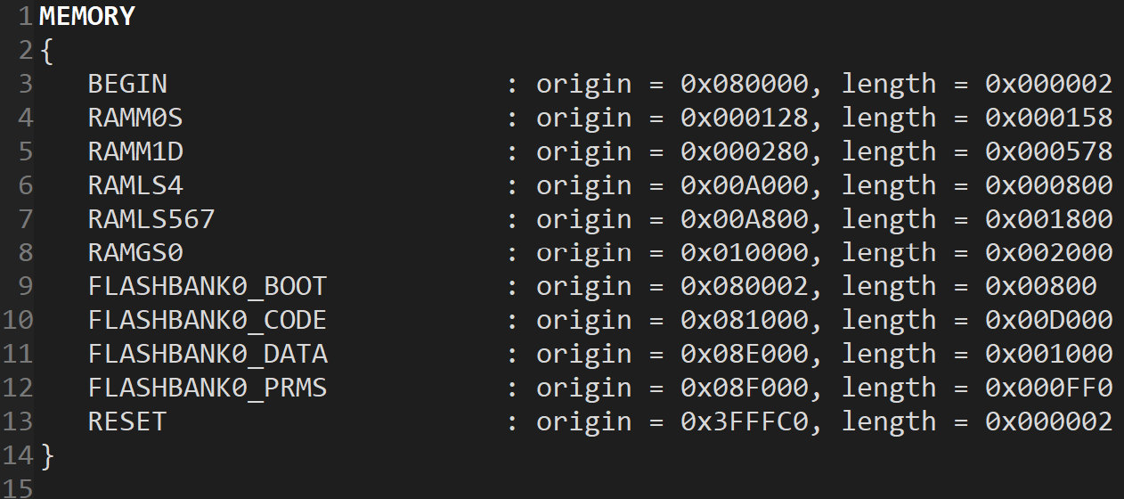
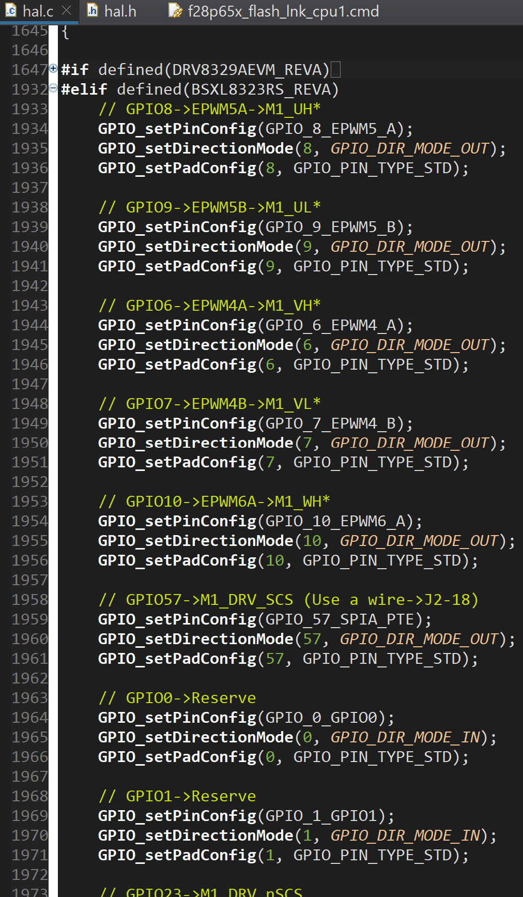
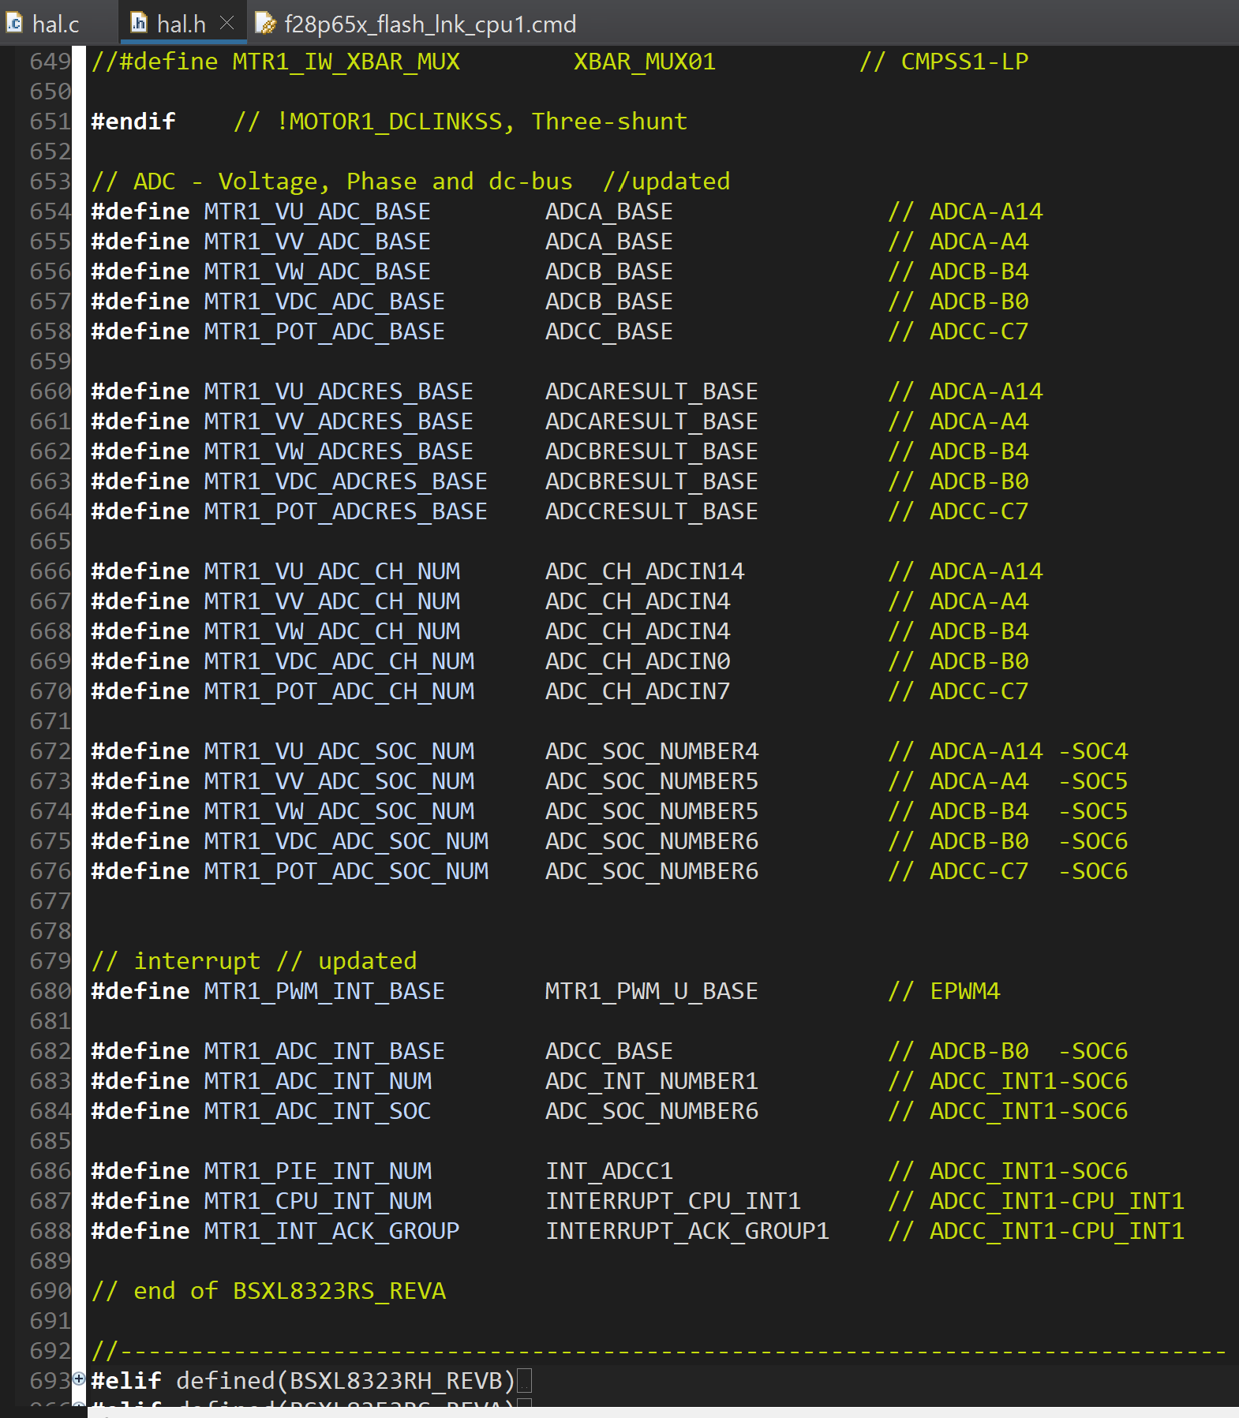

Slide 12
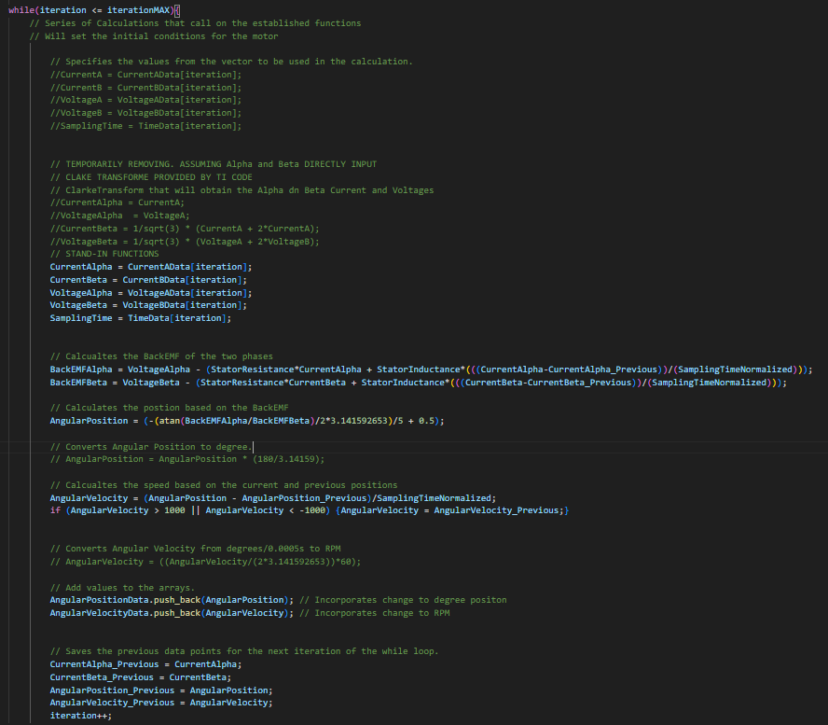
Estimator
System Overview
Accomplishments
Collecting all needed equations and constants for the code. Compiling all equations in a functioning code. Tuning Estimator Code to for accuracy under ideal conditions. Achieving near-identical to ideal expectations

Slide 13
Estimator
CONSTANTS:
Stator Induction and Resistance
Back EMF Constant
Sampling Time
INPUT:
Phase A: Current, Voltage
Phase B: Current, Voltage
Clarke Transform
Phase Alpha: Current, Voltage
Phase Beta: Current, Voltage
Back EMF CALCULATION:
Phase Alpha: Back EMF
Phase Beta: Back EMF
(Current-Previous)/Time:
Rotor Position Estimation
ATAN(Alpha/Beta):
Rotor Position Estimation
OUTPUT:
Rotor Position
Rotor Velocity

Slide 14
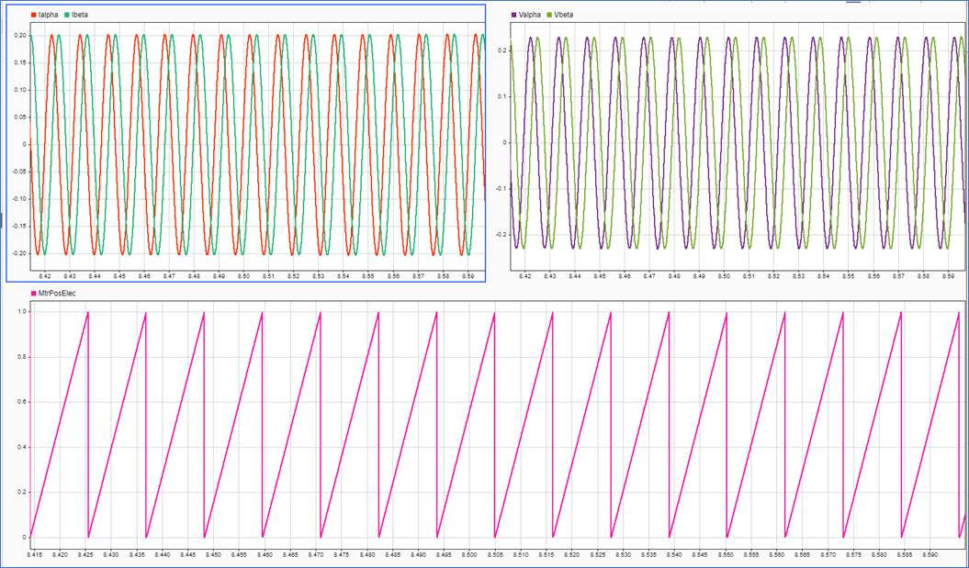
Estimator

Slide 15
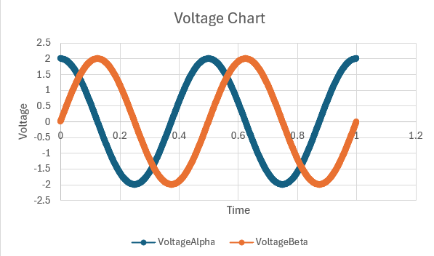
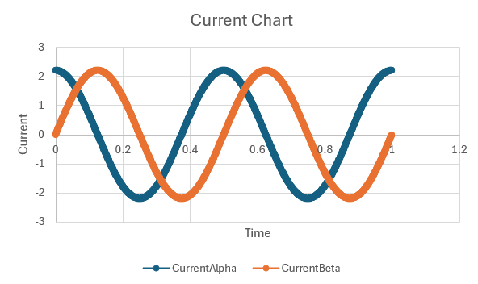
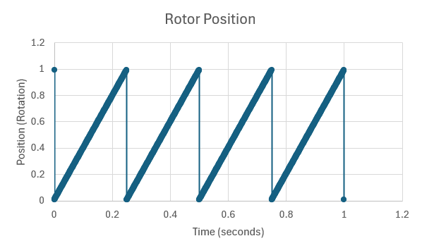
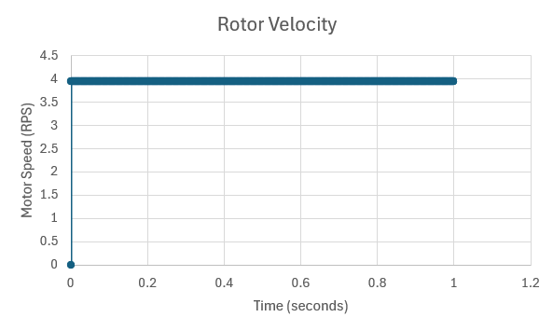
Estimator

Slide 16
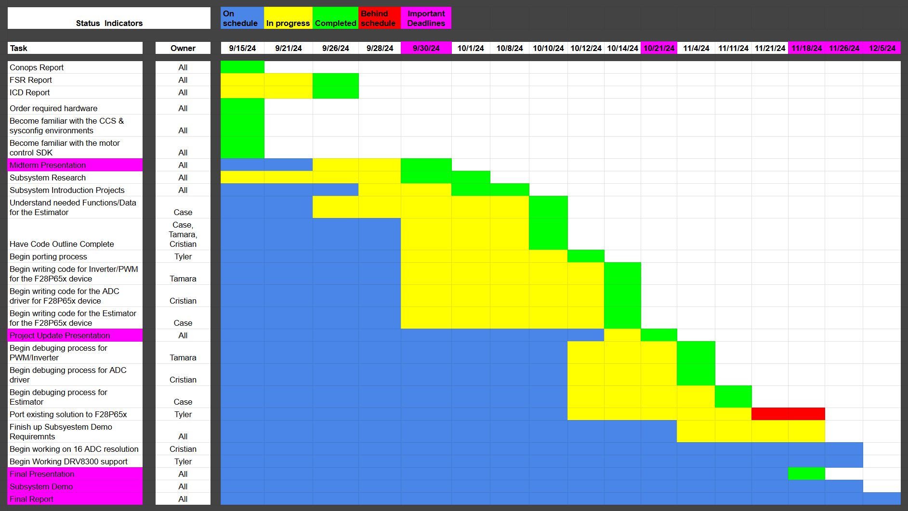
Execution plan

Slide 17
Validation Plan
Task | Specification | Result | Owner
Test individual function Operation (test cases) | Each block function outputs correct data and the integrated project compiles | TESTED | Tamara PWM
Test individual function Operation (in/out waveforms) | Waveforms behave as expected | TESTED | Tamara PWM
Compile Full PWM Project | Integrated project compiles | TESTED | Tamara PWM
Integrated Project Test | The PWM project shows correct duty cycles and can change in real time | TESTED | Tamara PWM
Test Estimator Operation | The estimator correctly collects motor information. This is done by comparing with sensored motor outputs | TESTED | Case EST
ADC Driver Operation | ADC Correctly converts Analog signal to digital signal through test cases and plotting | TESTED | Cristian ADC
ADC Overview | Code will compile with 0 errors. | TESTED | Cristian ADC
ADC/ GPIO Behavior | The memory result buffer will show the behavior of ADC A (Toggle) | TESTED | Cristian ADC
ADC/ GPIO Behavior | The memory result buffer will show the behavior of ADC B (Low) | In Progress | Cristian ADC

Slide 18
Validation Plan Continued…
Task | Specification | Result | Owner
ADC/ GPIO Behavior | The memory result buffer will show the behavior of ADC C (High) | TESTED | Cristian ADC
Plotting/ Graph | Code Composer Studio will show the PWM waveform updating in real time | TESTED | Cristian ADC
Plotting/ Graph | An oscilloscope will show the GPIO 3 toggling in regards to ADC A | TESTED | Cristian ADC
f28p65x Behavior | LEDs show the behavior of the GPIO pin on the f28p65x board | In Progress | Cristian ADC
System Compiling | Full system compile | TESTED | All
Motor control With sensorless Operation | The full system of a motor without using a sensor operates correctly on the F28002x board | TESTED | Tyler PORTING
Porting Solution onto F28p65x board | Ported solution compiles without any errors | In Progress | Tyler PORTING
Porting Solution onto F28p65x board | Ported motor control software onto f28p65x board successfully. | In Progress | Tyler PORTING

Slide 19
404 Goals
Task | Specification | Result
SysConfig support | The system correctly operates using the SysConfig IDE
16 Bit ADC resolution | The system correctly operates using 16-bit ADC resolution
12 Bit & 16 Bit ADC resolution Support | The system correctly operates using either 12-bit or 16-bit ADC resolutions
64-bit Floating point operation | The system Correctly Operates using 64-bit Floating Point
32-bit & 64-bit Floating point operation | The system Correctly Operates using either 32-bit or 64-bit Floating Point
Test 12 vs 16 Bit performance | Test the accuracy of both 12-bit and 16-bit ADC resolutions when compared to a motor with a sensor
Test 32-bit & 64-bit Floating point operation | Test the accuracy of both 32-bit and 64-bit ADC Floating point operations when compared to a motor with a sensor
Test the effectiveness of oversampling | Test the effectiveness of oversampling by comparison to the old system using a sensor(older board did not support oversampling)

